Slide 1
FORECAST HOTEL BOOKING DEMAND WITH ECONOMIC INDICATORS
CIND 820
Author: Aparna Mohankumar
ID: 501158828

Slide 2
Project Objective
To perform data analysis, generate efficient classification model on Hotel Booking Dataset with Economic Indicators, to classify the outcomes, to predict if they will result in cancellations or not.
Leveraging Data
Data-driven Decision-Making
Profitability and Revenue Maximization
Demand Forecasting for Revenue Management

Slide 3




Data Source
Original dataset article Hotel Booking Demand Datasets, written by Nuno Antonio, Ana Almeida, and Luis Nunes for Data in Brief, Volume 22, February 2019.
Leading Economic Indicators from US using FRED.
Finally sourced from Kaggle, combined dataset by Marquis Lardinois.
Author created a GitHub repository to store relevant documentation for analysis.

Slide 4
Methodology
Missing value treatment
Handle Outliers
Study correlation
Feature selection
Import Data
Data preprocessing
Split into Training and Test Data
Perform EDA
Perform Hyperparameter Tuning using RandomizedSearchCV to find best parameter for XGBoost.
Train the model.
Evaluate Performance on Test data.
Compare Models on StratifiedKfold CV performance.
Model Selection
Compare models
Choose Best performance efficiency
Perform Hyperparameter Tuning using RandomizedSearchCV to find best parameter for Random Forest.
Train the model.
Evaluate Performance on Test data.

Slide 5
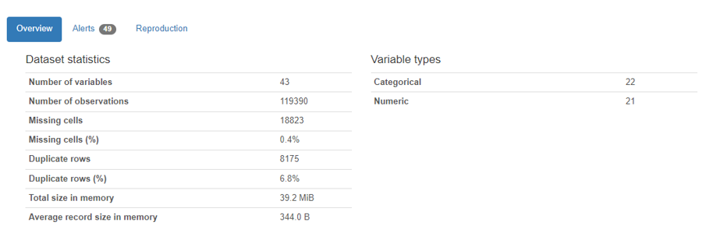
Data collection & Data Preprocessing
119390 records with 43 data variables.
Target variable is_canceled can take values 0 or 1.
Variables have time information, categorical and numeric variables.

Slide 6
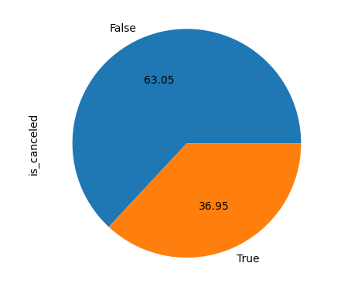
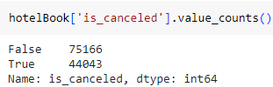
Split into Training and Test Data
Dataset is split: 70% Training data 30% Testing data.
Split is stratified by categories in Target variable is_canceled.

Slide 7
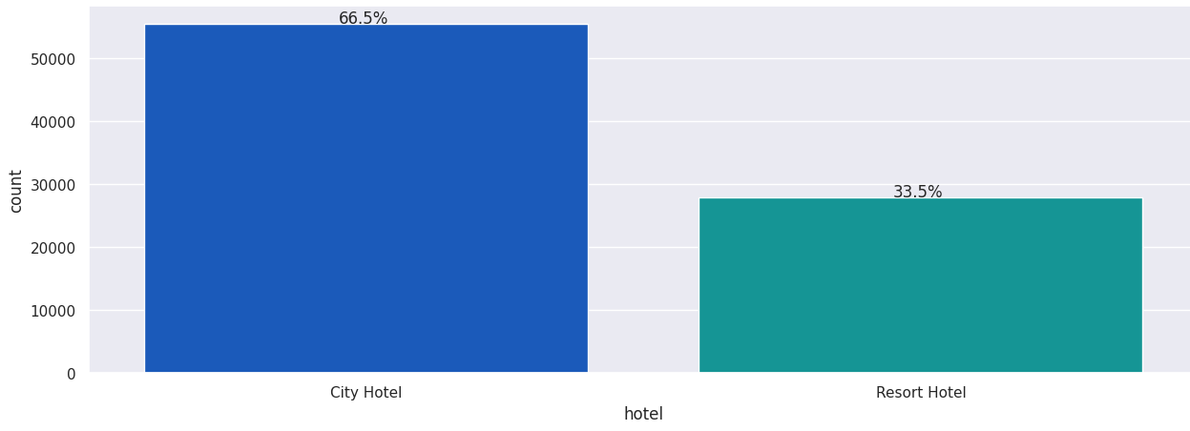
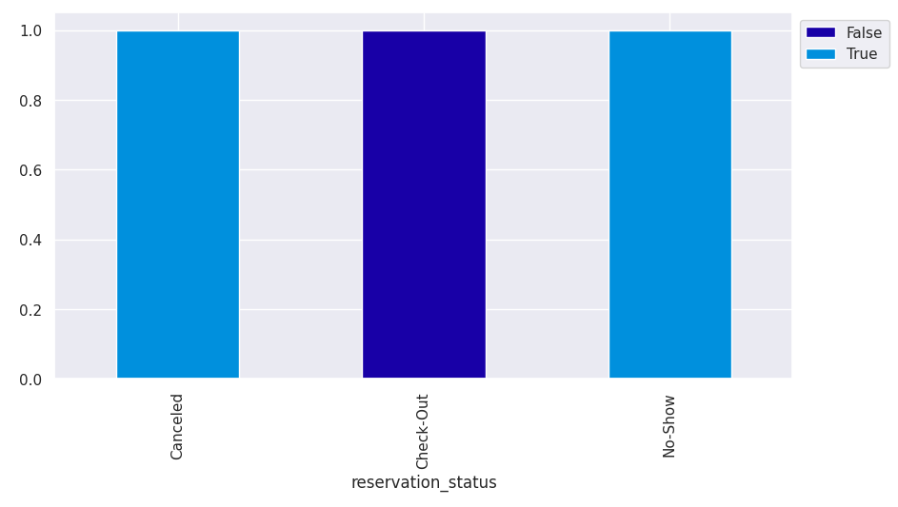
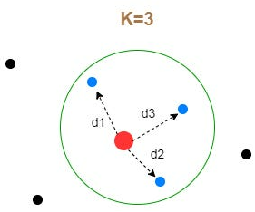
Exploratory Data Analysis
Univariate plot of hotel
Missing Values in children, agent, economic indicators.
Detecting Outliers and handling
Univariate Analysis
Bivariate Analysis
Bivariate plot of reservation_status vs target
KNN imputer

Slide 8
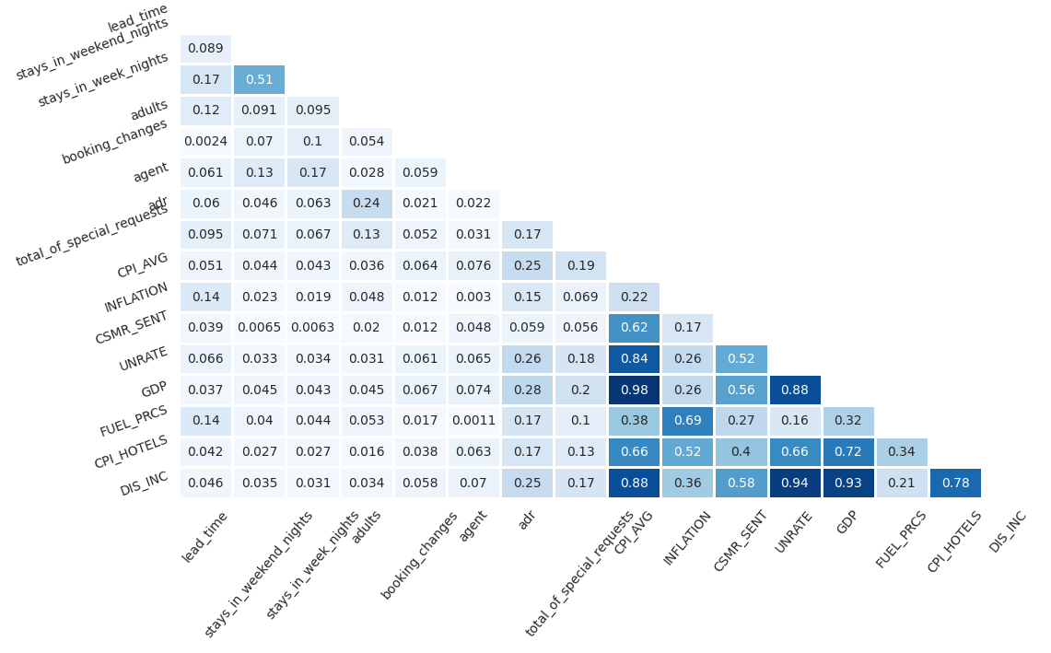
Exploratory Data Analysis (1)
Correlation between independent variables

Slide 9
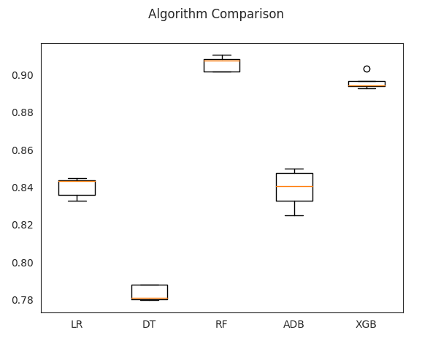
Algorithm Comparison
Evaluating models between Logistic Regression, Decision Tree, Random Forest, AdaBoost, XGBoost using StratifiedKFold CV.
Scoring Criteria Precision.
Choose models based on Best Performance and Efficiency.
RF training time: 56.76s
XGB training time: 6.25s

Slide 10
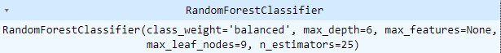
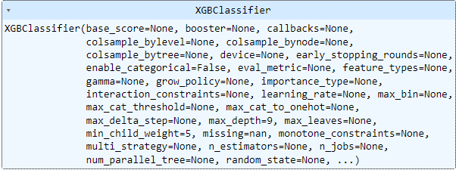
Hyperparameter Tuning
RandomizedSearchCV for best Random Forest parameter (time=1min 15s)
RandomizedSearchCV for best XGBoost parameter (time=2 min 10s)

Slide 11
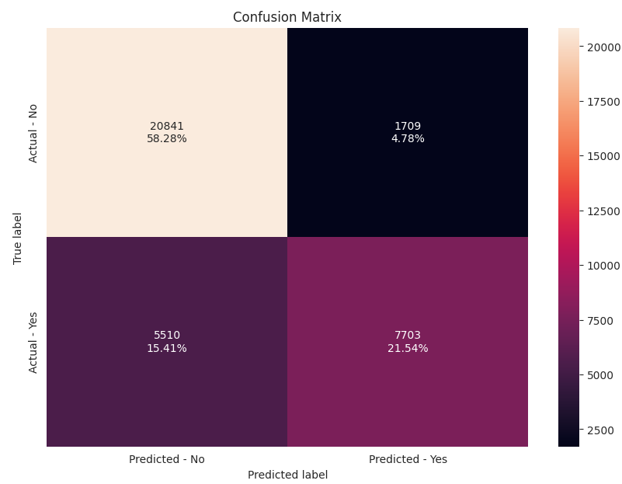
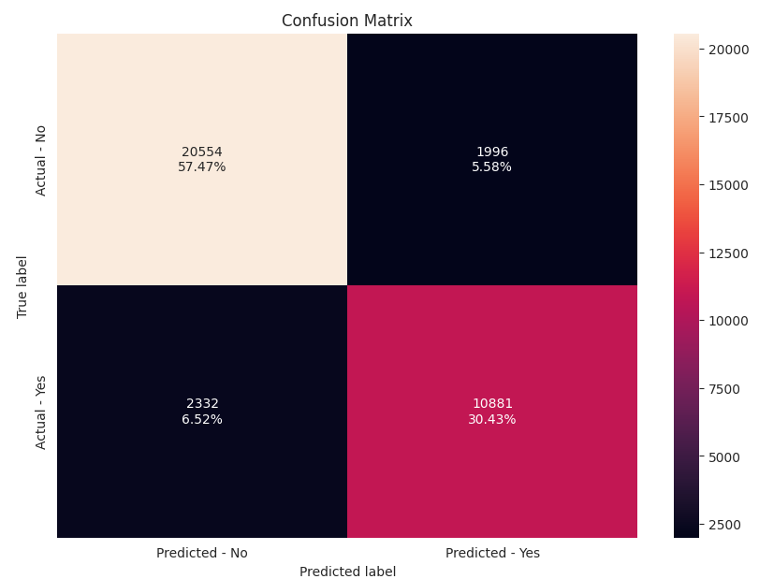
Model Performance Comparison
Random Forest
XGBoost
Tuning time: 1 min 15s
Model training time: 4.64s
Testing Accuracy: 0.798
Precision score: 0.818
Tuning time: 2 min 10s
Model training time: 1.78s
Testing Accuracy: 0.879
Precision score: 0.845

Slide 12
Conclusion
Customer Segmentation and Satiation.
Precision is improved to encourage potential revenue sources.
Future analysis should focus on Time stratified analysis.
Identify seasonality, Target Ideal Customer.

Slide 13
XGBoost is better than Random Forest model forecast.

Slide 14
References
https://doi.org/10.34740/KAGGLE/DSV/6481528 [Kaggle]
Marquis Lardinois. (2023). Hotel Booking Demand with Economic Indicators [Data set].
https://ieeexplore.ieee.org/document/8260781 N. Antonio, A. Almeida, L. Nunes, Predicting hotel bookings cancellation with a machine learning classification model, in: Proceedings of the 16th IEEE International Conference Machine Learning Application, IEEE, Cancun, Mexicopp. 1049–1054. doi:10.1109/ICMLA.2017.00-11, 2017
https://doi.org/10.1016/j.dib.2018.11.126 [ScienceDirect] N. Antonio, A. Almeida, L. Nunes, Hotel booking demand dataset.
Project repository: https://github.com/aparnamohankumar18/hotel_booking

Slide 15
QUESTIONS AND FEEDBACK
THANK YOU

